Slide 1



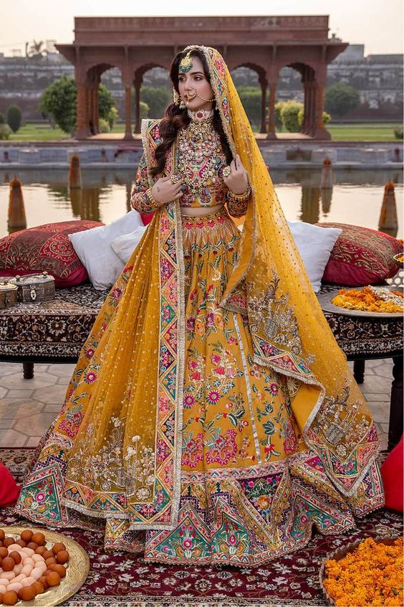
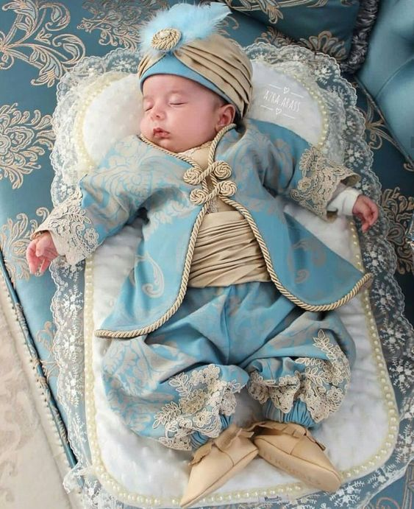
BOUTIQUE MANAGEMENT SYSTEM
Jenisha Shrestha (770315) Kritima Shrestha (770318) Sarif Tachamo (770338)
"Express your style with confidence through fashionable dressing."

Slide 2
Introduction
The boutique management system is a powerful software solution specifically tailored to meet the needs of boutique businesses. It offers a range of integrated tools and features to simplify and optimize various aspects of boutique management.
From inventory management and tracking stock levels to handling sales transactions and customer relationships, this system streamlines operations and enhances efficiency. With its user-friendly interface, it provides real-time data insights and reporting capabilities, enabling boutique owners and managers to make informed decisions. By automating tasks and centralizing information, the boutique management system empowers businesses to improve productivity, maximize sales, and deliver exceptional customer experiences.

Slide 3
PROJECT BREAKDOWN
Boutique Management System

Slide 4
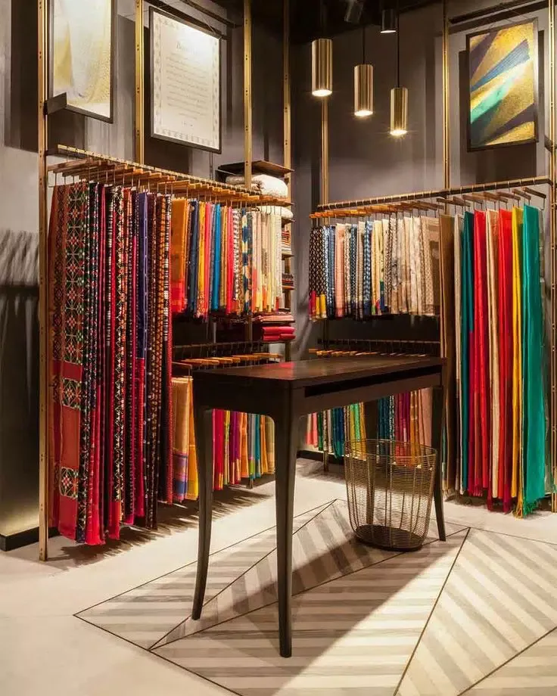
Overall Concept
Admin
Insert
Update
Delete
Designer
Men
Wear
Women
Wear
Customer
Order

Slide 5
INDEX PAGE
User Login
Admin Login

Slide 6
HOMEPAGE OF USER
About Us
Product
Contact Us
Logout

Slide 7
FUNCTIONS
ADMIN
USER
Insert Products
Update Products
Delete Products
View Products
View Products
Add to Carts
Order Products

Slide 8
MOTIVATION
Streamlined operations and increased efficiency
Optimized inventory management
Improved customer experience and satisfaction
Time and cost savings through automation
Integration with multiple sales channels

Slide 9
OBJECTIVES
Facilitate effective marketing and customer relationship management.
Time saving through online platform
Provide high quality products as per demand
Avoid scams and duplicate products

Slide 10
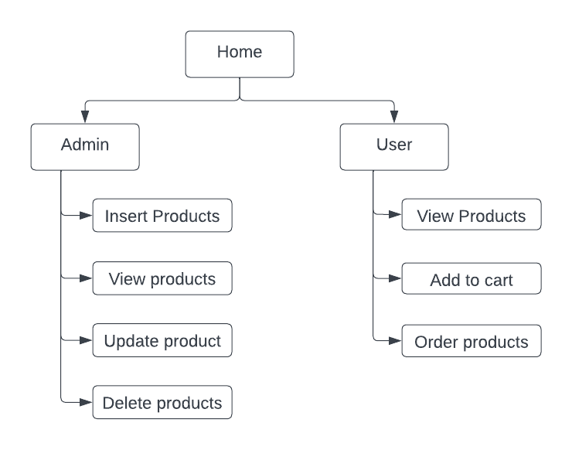
METHODOLOGY
1. Generic Model
Login

Slide 11
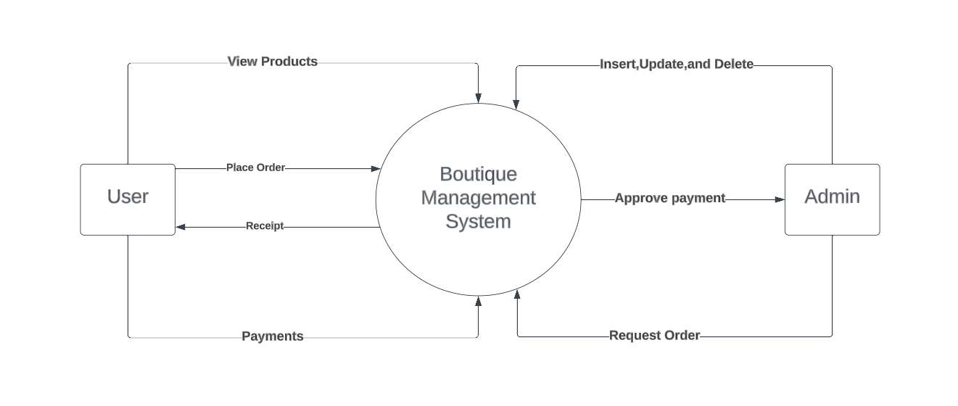
METHODOLOGY
2. Context Diagram

Slide 12
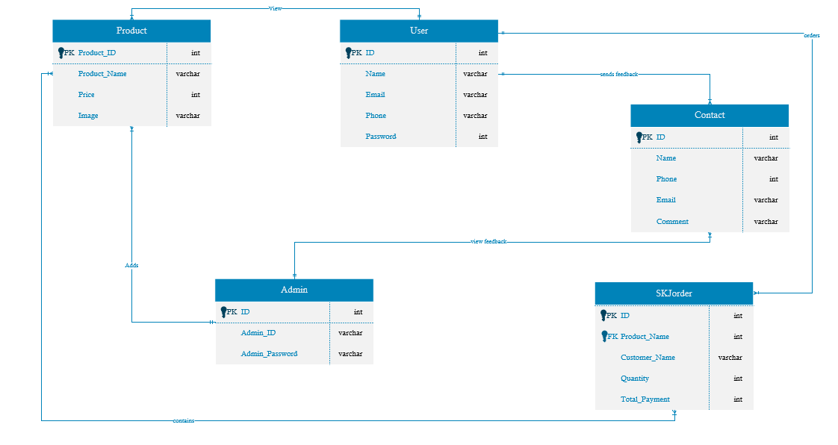
METHODOLOGY
3. ER Diagram

Slide 13
Tools and Platforms Used
Operating System Used Windows
Language Used HTML, CSS, JavaScript, PHP, MySQL
Software Used VS Code, XAMPP

Slide 14
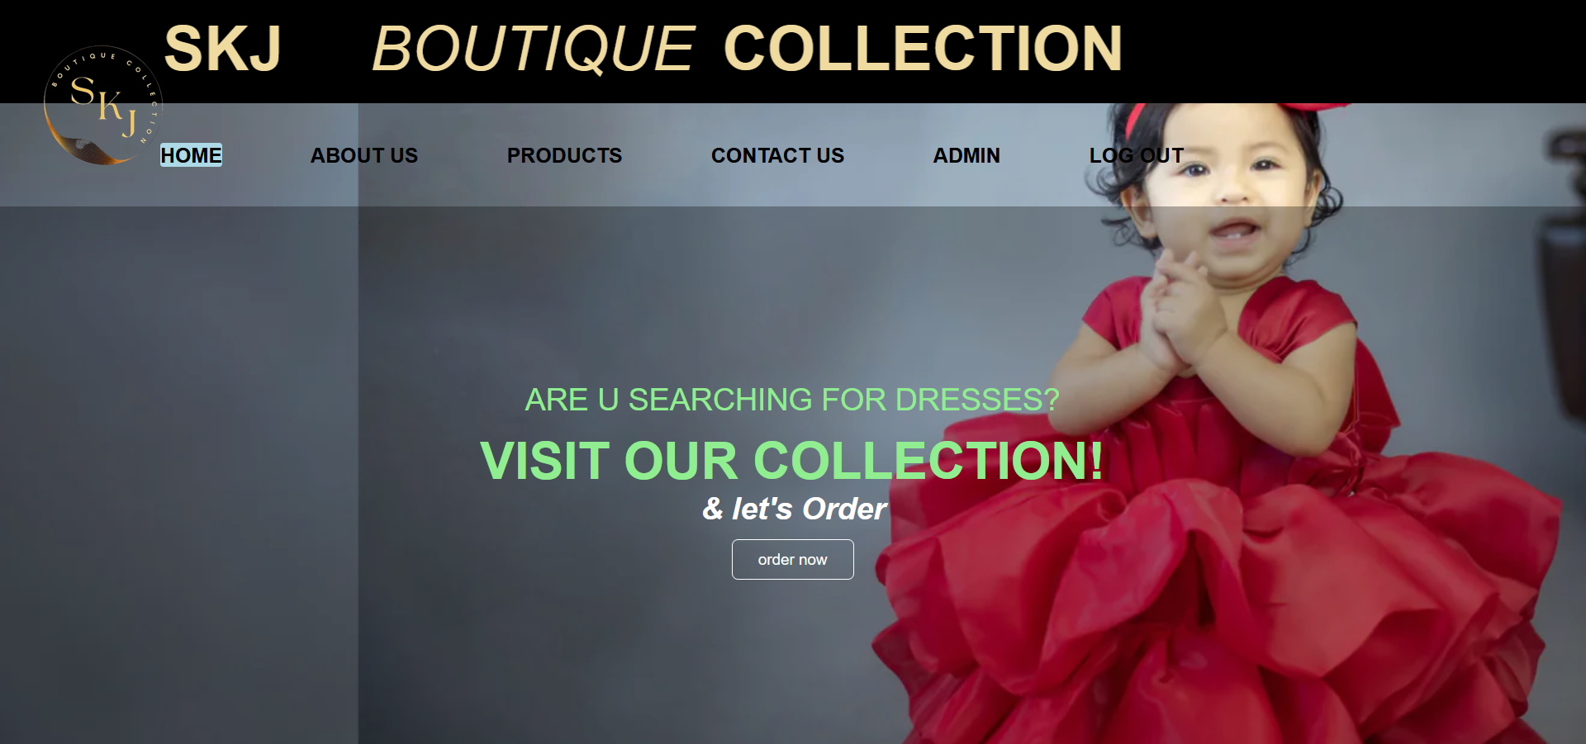
SCREENSHOTS
1.Homepage Of User

Slide 15
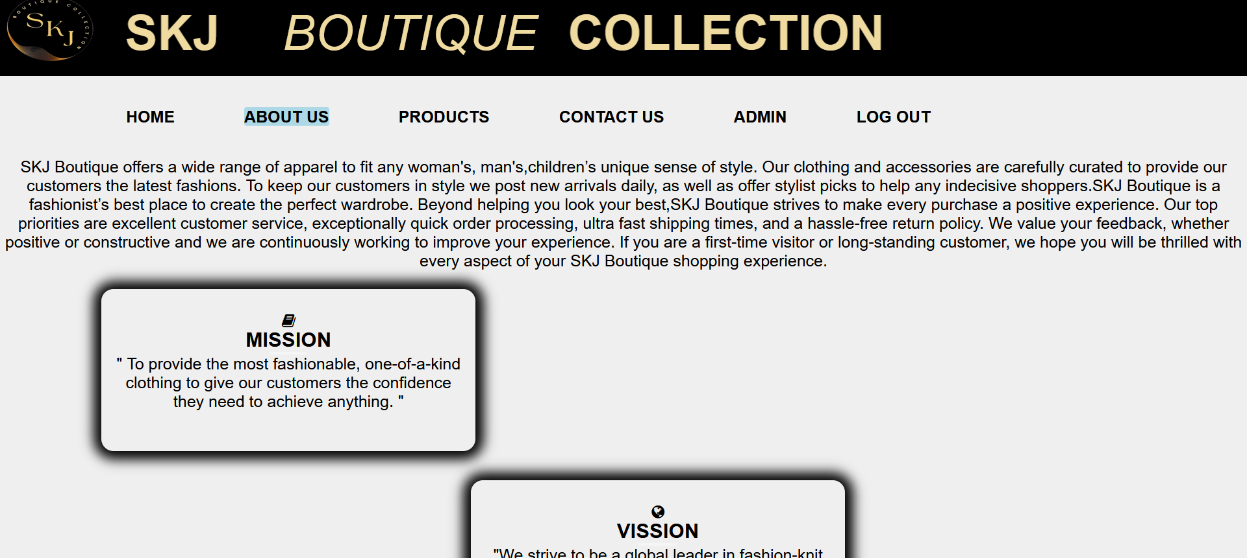
2. About Us

Slide 16
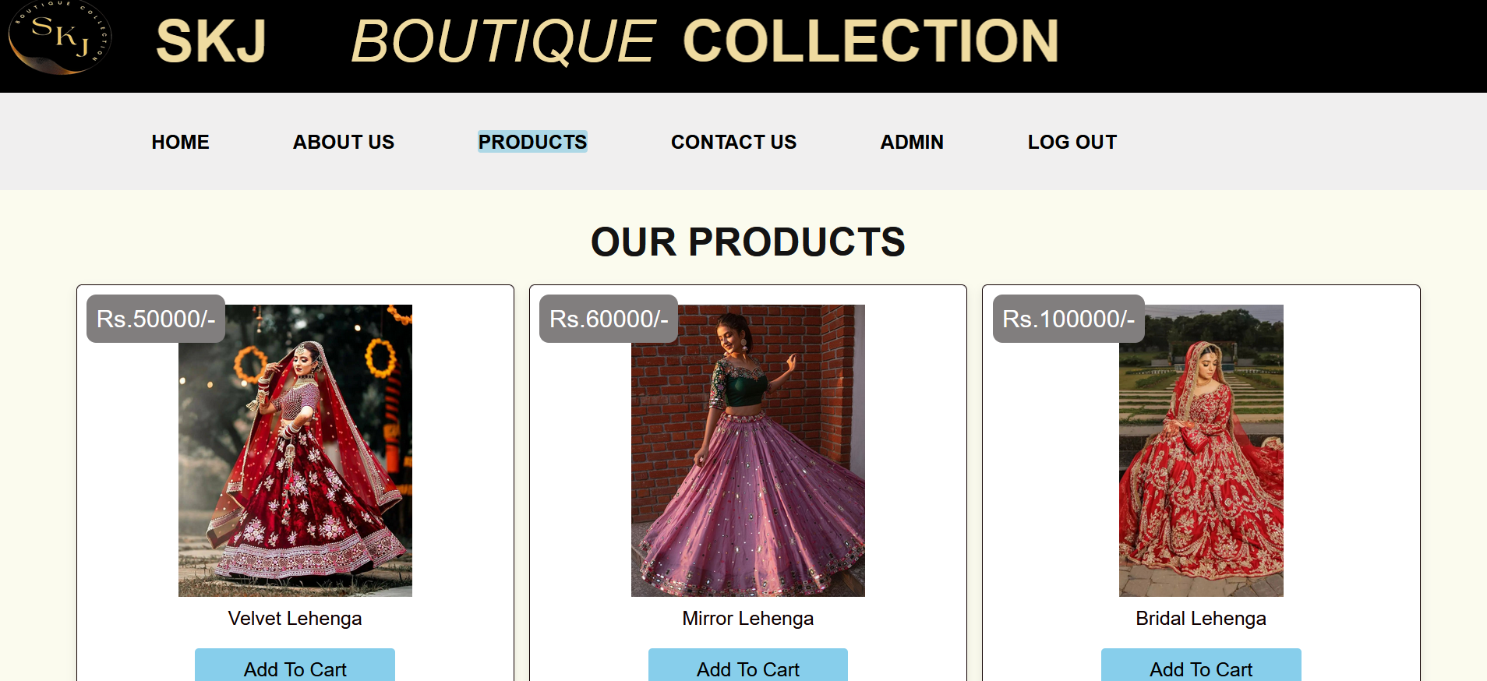
3. Our Products Section

Slide 17
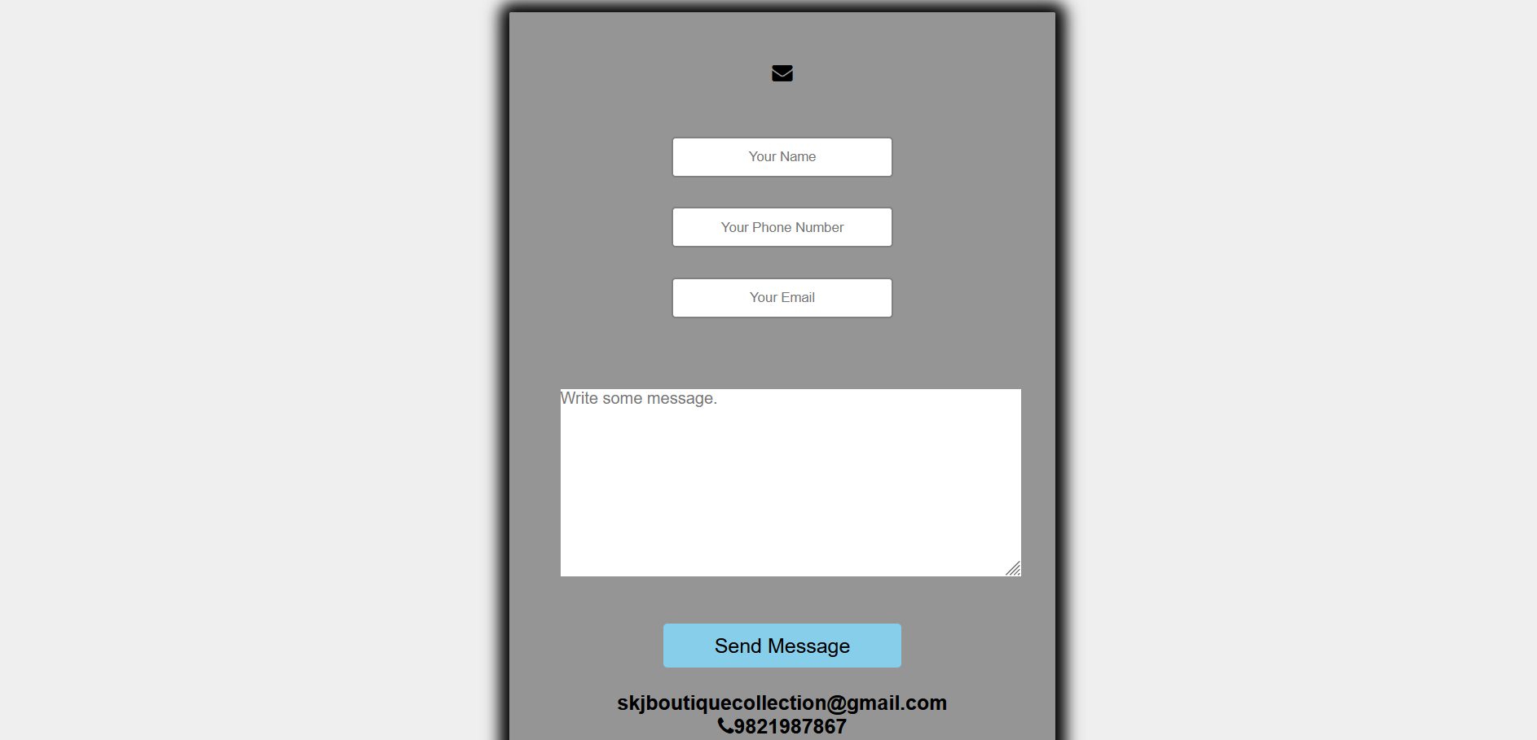
4. Contact Us

Slide 18
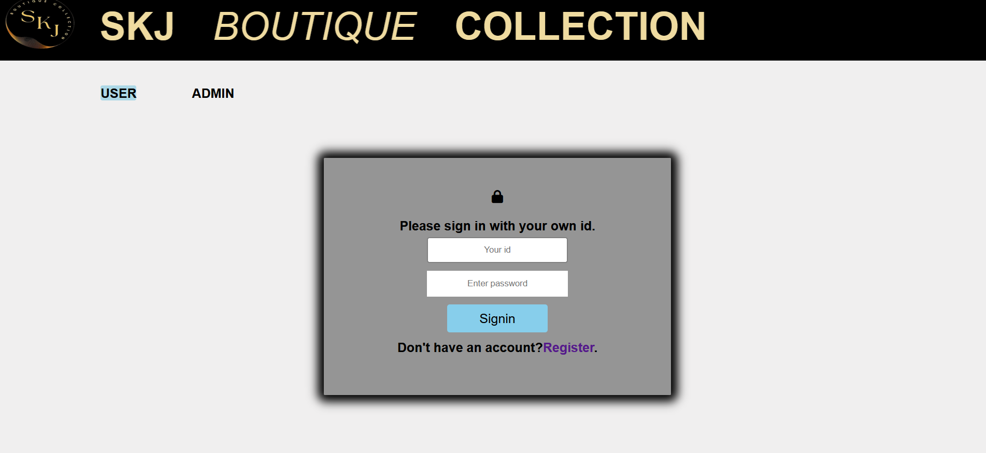
5. Index Page
a. User Sign in

Slide 19
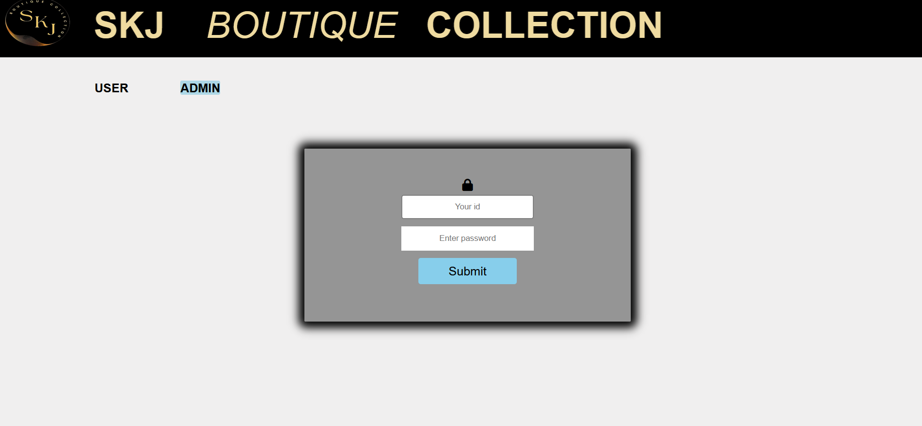
b. Admin Sign In

Slide 20
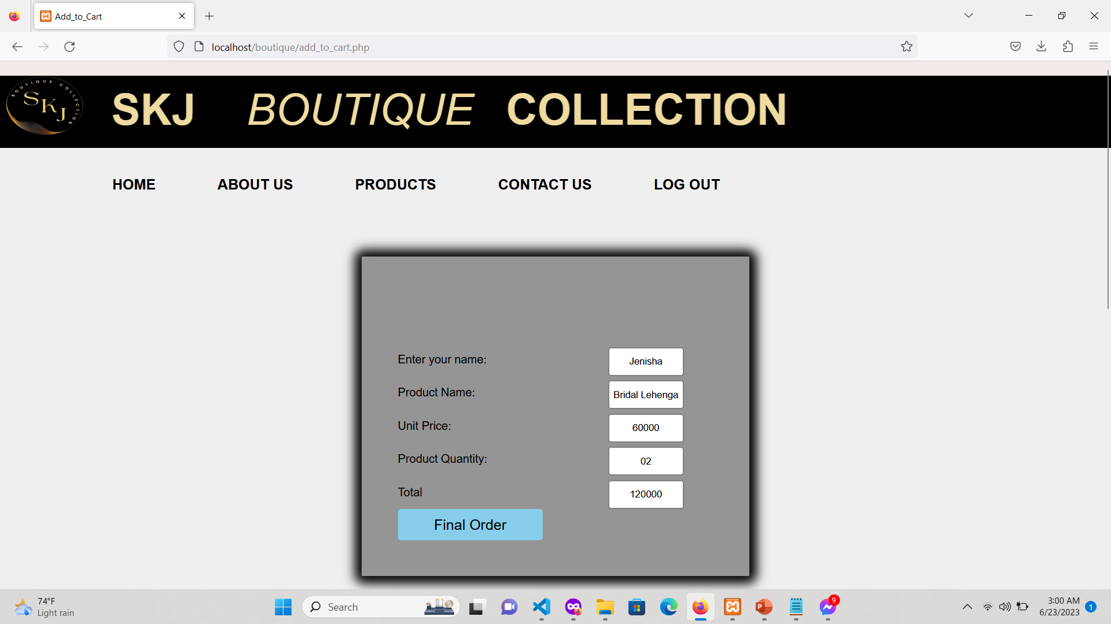
6.Cart Section

Slide 21
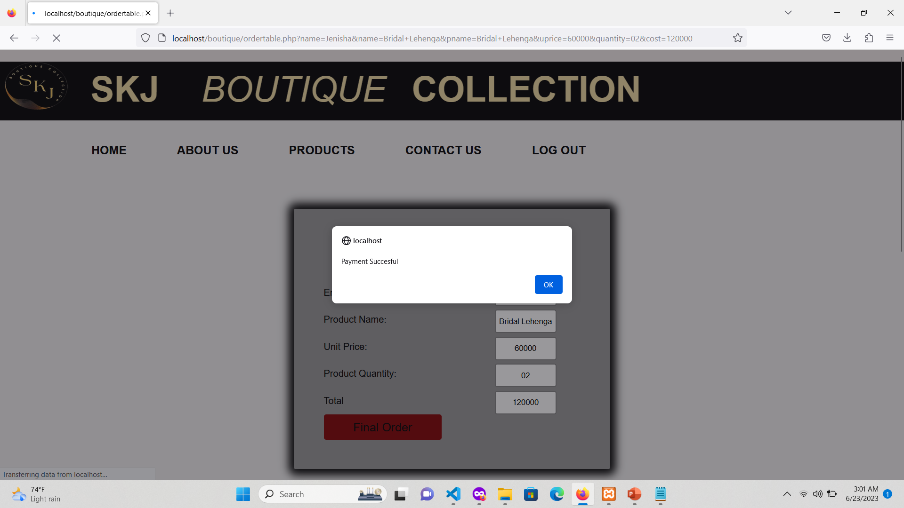
7. Successful Payment

Slide 22
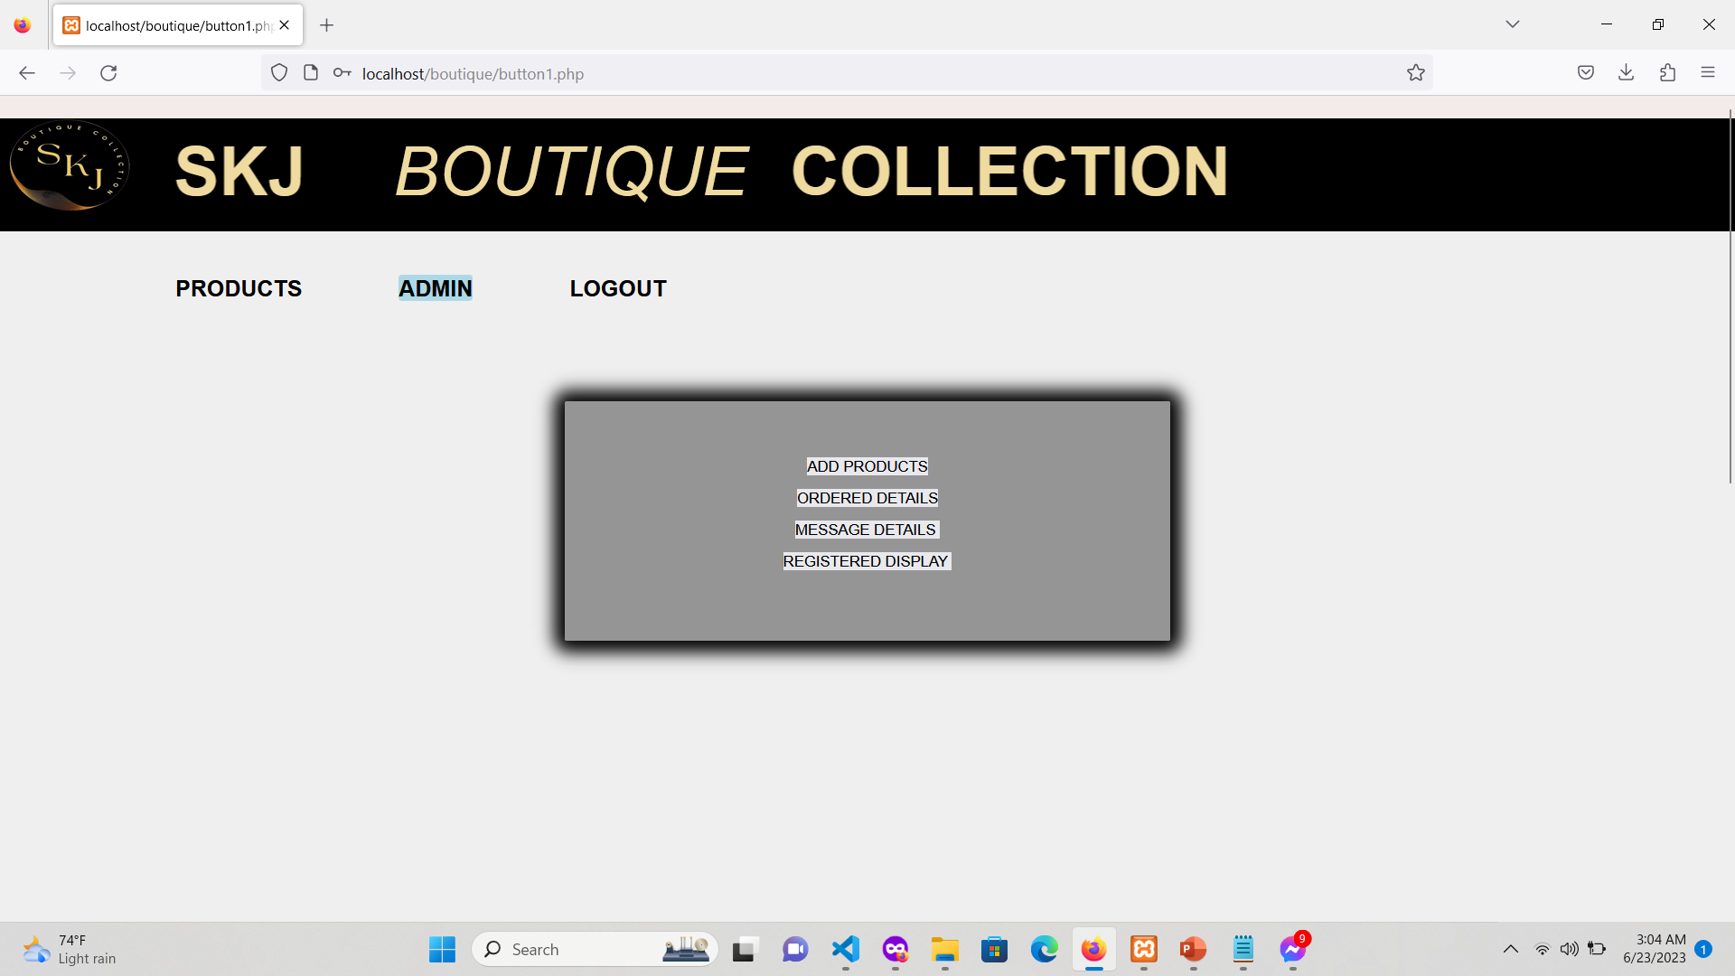
8. Admin Functionality Section

Slide 23
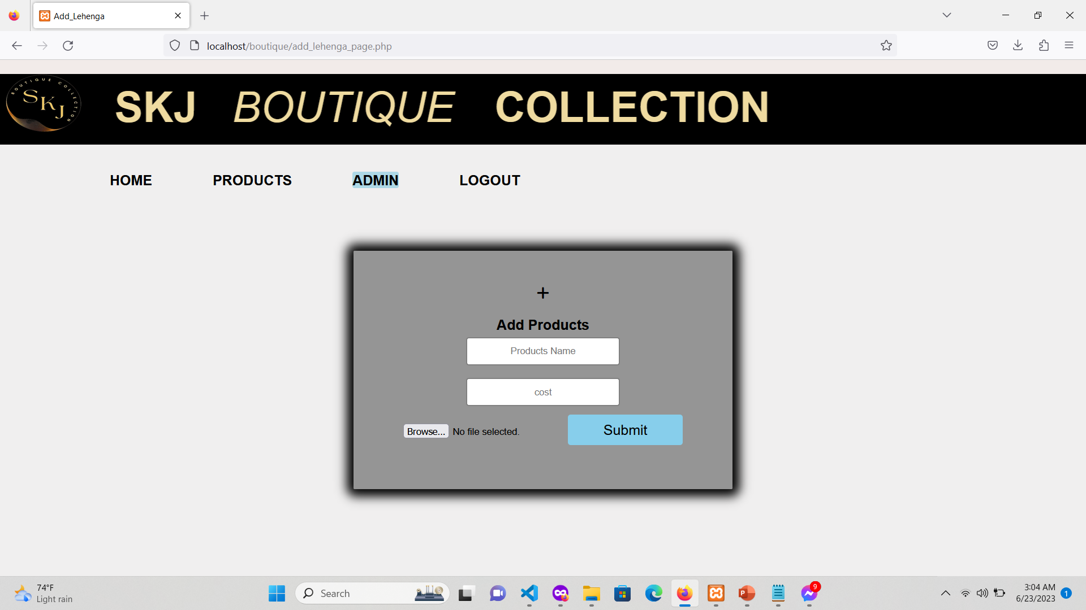
9. Add Product Section By Admin

Slide 24
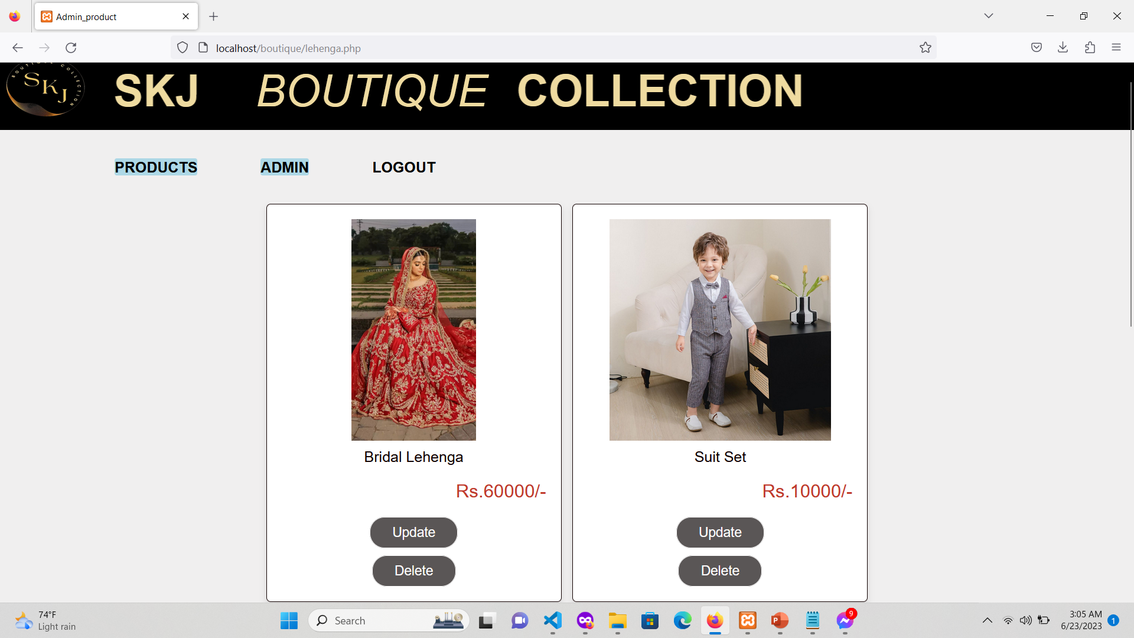
10. Product Section By Admin

Slide 25
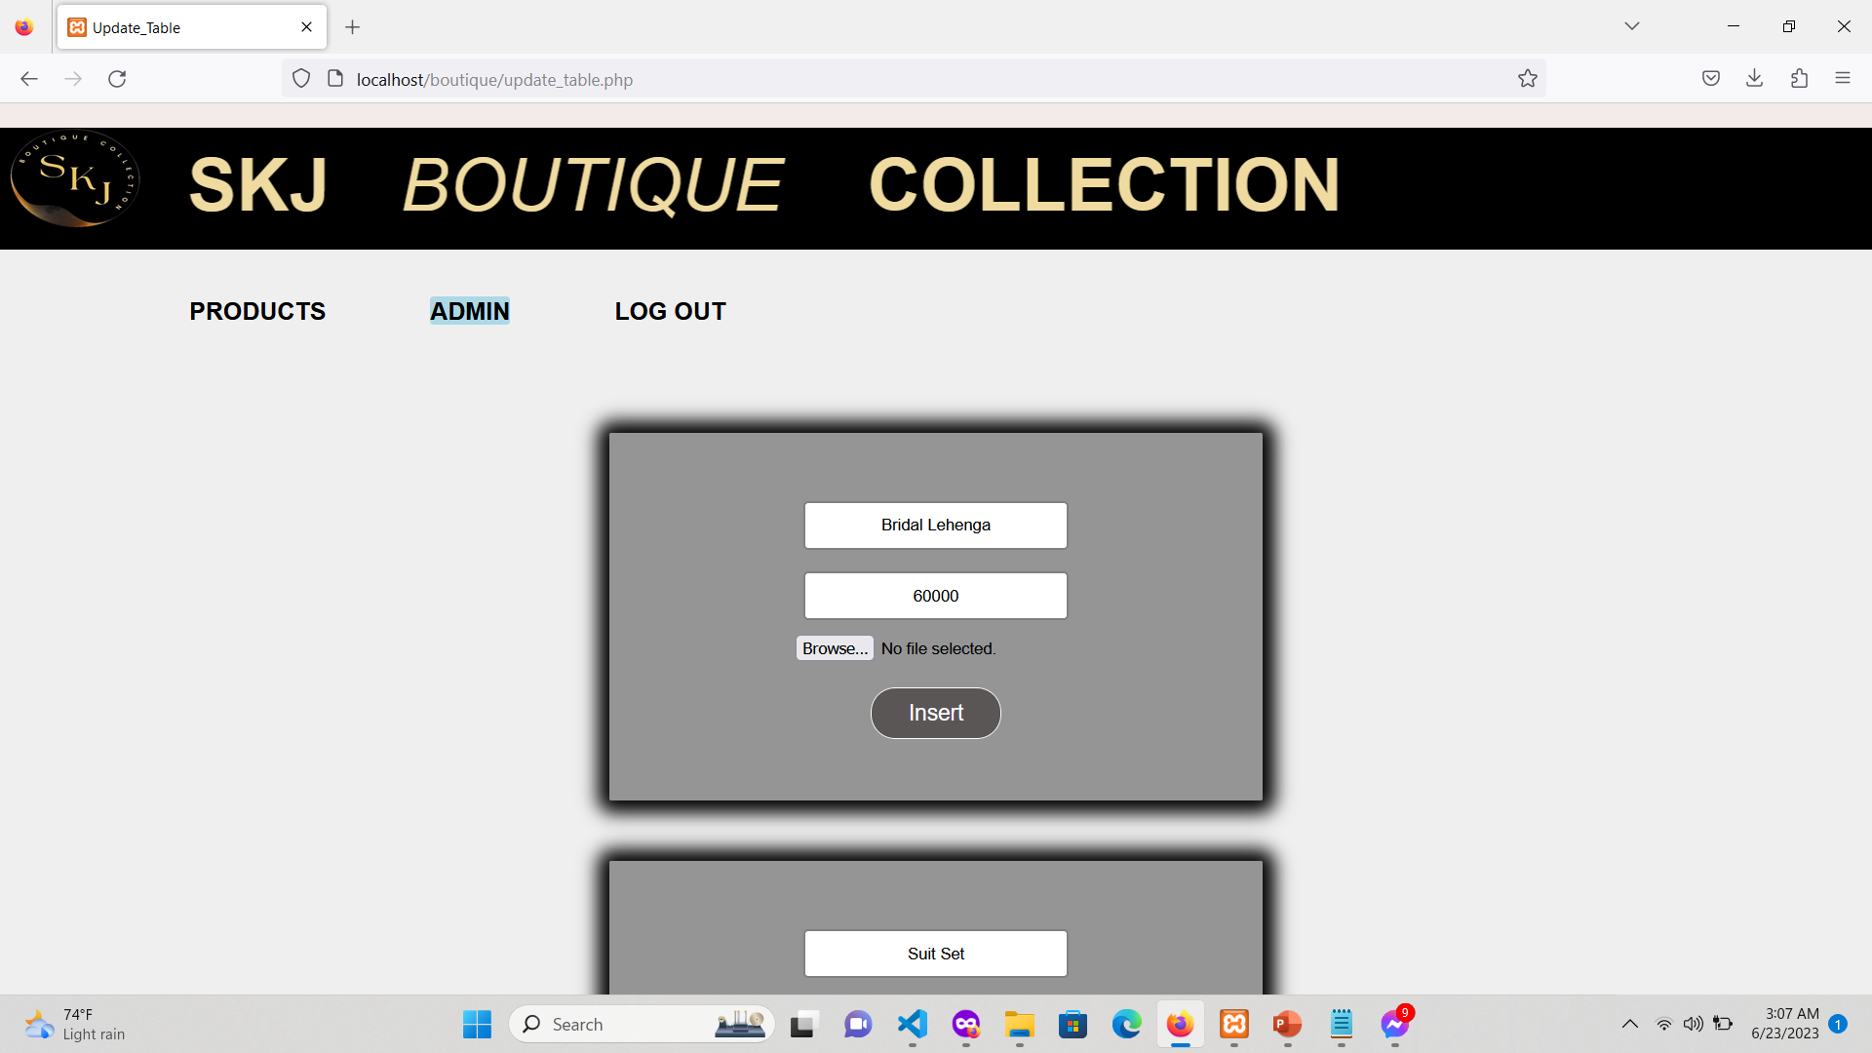
11. Data Insertion Section

Slide 26
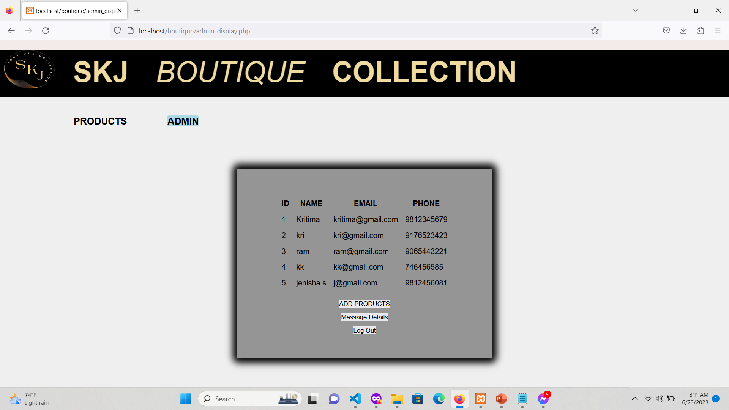
12. Registered Section

Slide 27
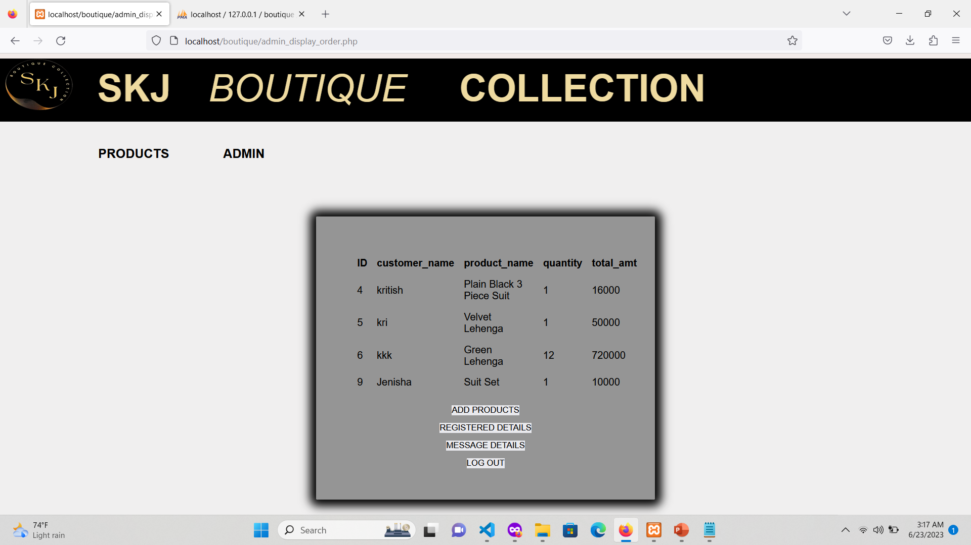
13. Ordered Section

Slide 28
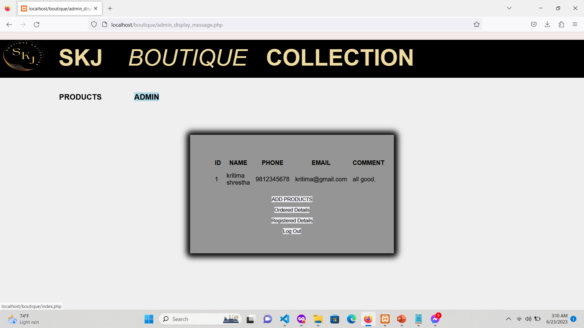
14. Update Product Details Section

Slide 29
RESULTS AND DISCUSSION
Improved operational efficiency and productivity.
Increased customer satisfaction through personalized services and targeted marketing
CRUD operation of products through admin
Must be registered to order products
User order the products

Slide 30
Future Enhancement
Update Image of products by Admin.
Delivery System
Multiple Order at once

Slide 31

Thank You !!!
“Thank you for making us a part of your stylish journey”

